Slide 1
SoC Estimation
Peerapol Yuvapoositanon

Slide 2
State of Charge (SoC) Estimation Methods: Overview and Comparison
In battery management systems (BMS), State of Charge (SoC) is like a fuel gauge for batteries — it tells how much usable energy remains. However, you can't measure SoC directly, like you can measure voltage or current. Instead, we estimate it.
There are five major classes of SoC estimation methods:

Slide 3
Category | Main Methods | Example Techniques
Direct Measurement | Voltage-based | Open Circuit Voltage (OCV)
Coulomb Counting | Current integration | Ampere-hour counting
Model-Based Estimation | Equivalent Circuit Models (ECM) | Kalman Filters (KF, EKF, UKF)
Adaptive / Observer-based | Online correction during operation | Luenberger Observer, Sliding Mode Observer
Data-Driven / AI-based | Machine Learning | Neural Networks (NN), Support Vector Machines (SVM)

Slide 4
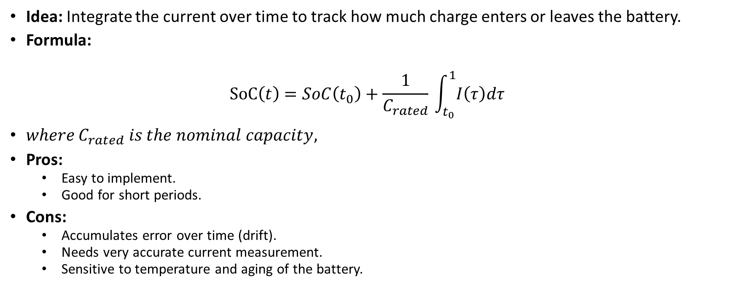
Coulomb Counting (Current Integration)
Idea: Integrate the current over time to track how much charge enters or leaves the battery.
Formula:
$$SoC\left(t\right)=SoC\left(t_{0}​\right)+\frac{1}{C_{rated}}​\int_{t_{0}}^{1}{​I\left(τ\right)dτ}$$
$where C_{rated}​ is the nominal capacity,$
Pros:
Easy to implement.
Good for short periods.
Cons:
Accumulates error over time (drift).
Needs very accurate current measurement.
Sensitive to temperature and aging of the battery.

Slide 5
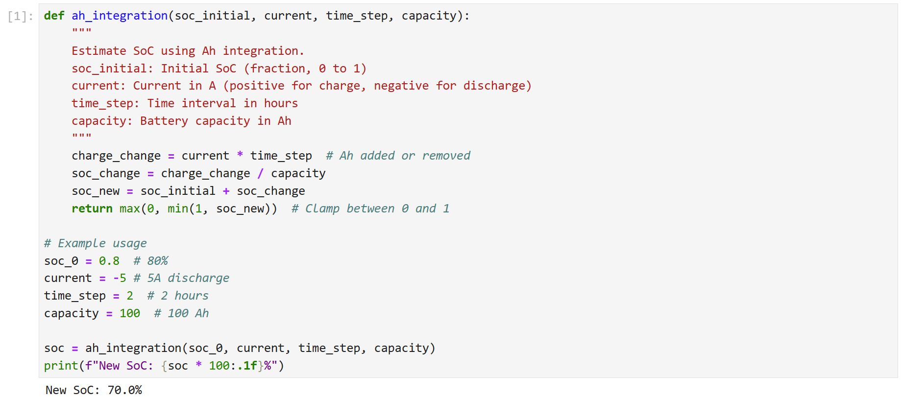
Ah Integration Method

Slide 6
Direct Measurement Methods
Example: Open Circuit Voltage (OCV)
Idea: SoC correlates to battery voltage when the battery is at rest (no current flowing).
Pros:
Very simple.
No complex modeling required.
Cons:
Only accurate when the battery is at rest for a long period (several hours sometimes).
Not usable during active operation (driving an EV, for example).

Slide 7







OCV Method
$$SoC_{V} =S_{0}+(S_{1}−S_{0})\frac{V−V_{0}}{V_{1}−V_{0}}$$
SoC
$$S_{1}$$
$$SoC_{V}$$
$$S_{0}$$
$$V_{0}$$
$$V$$
OCV
$$V_{1}$$

Slide 8
